Slide 1

CE 623 Pavement Evaluation, Rehabilitation and Maintenance
Pavement Evaluation and Types of Pavement Distress
Presented By Group 1
Abhishek Kumar
Golla Naveen
Harischandra Chouryal
Himanshu Choudhary
Himanshu Nirwan
Mayank Semwal
Pankaj Kumar

Slide 2
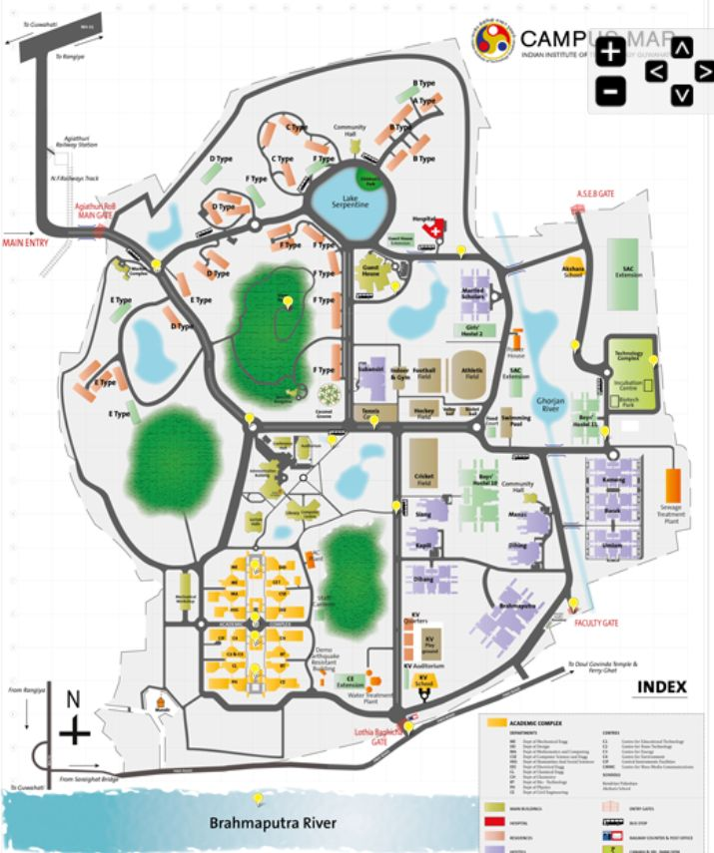

Slide 3
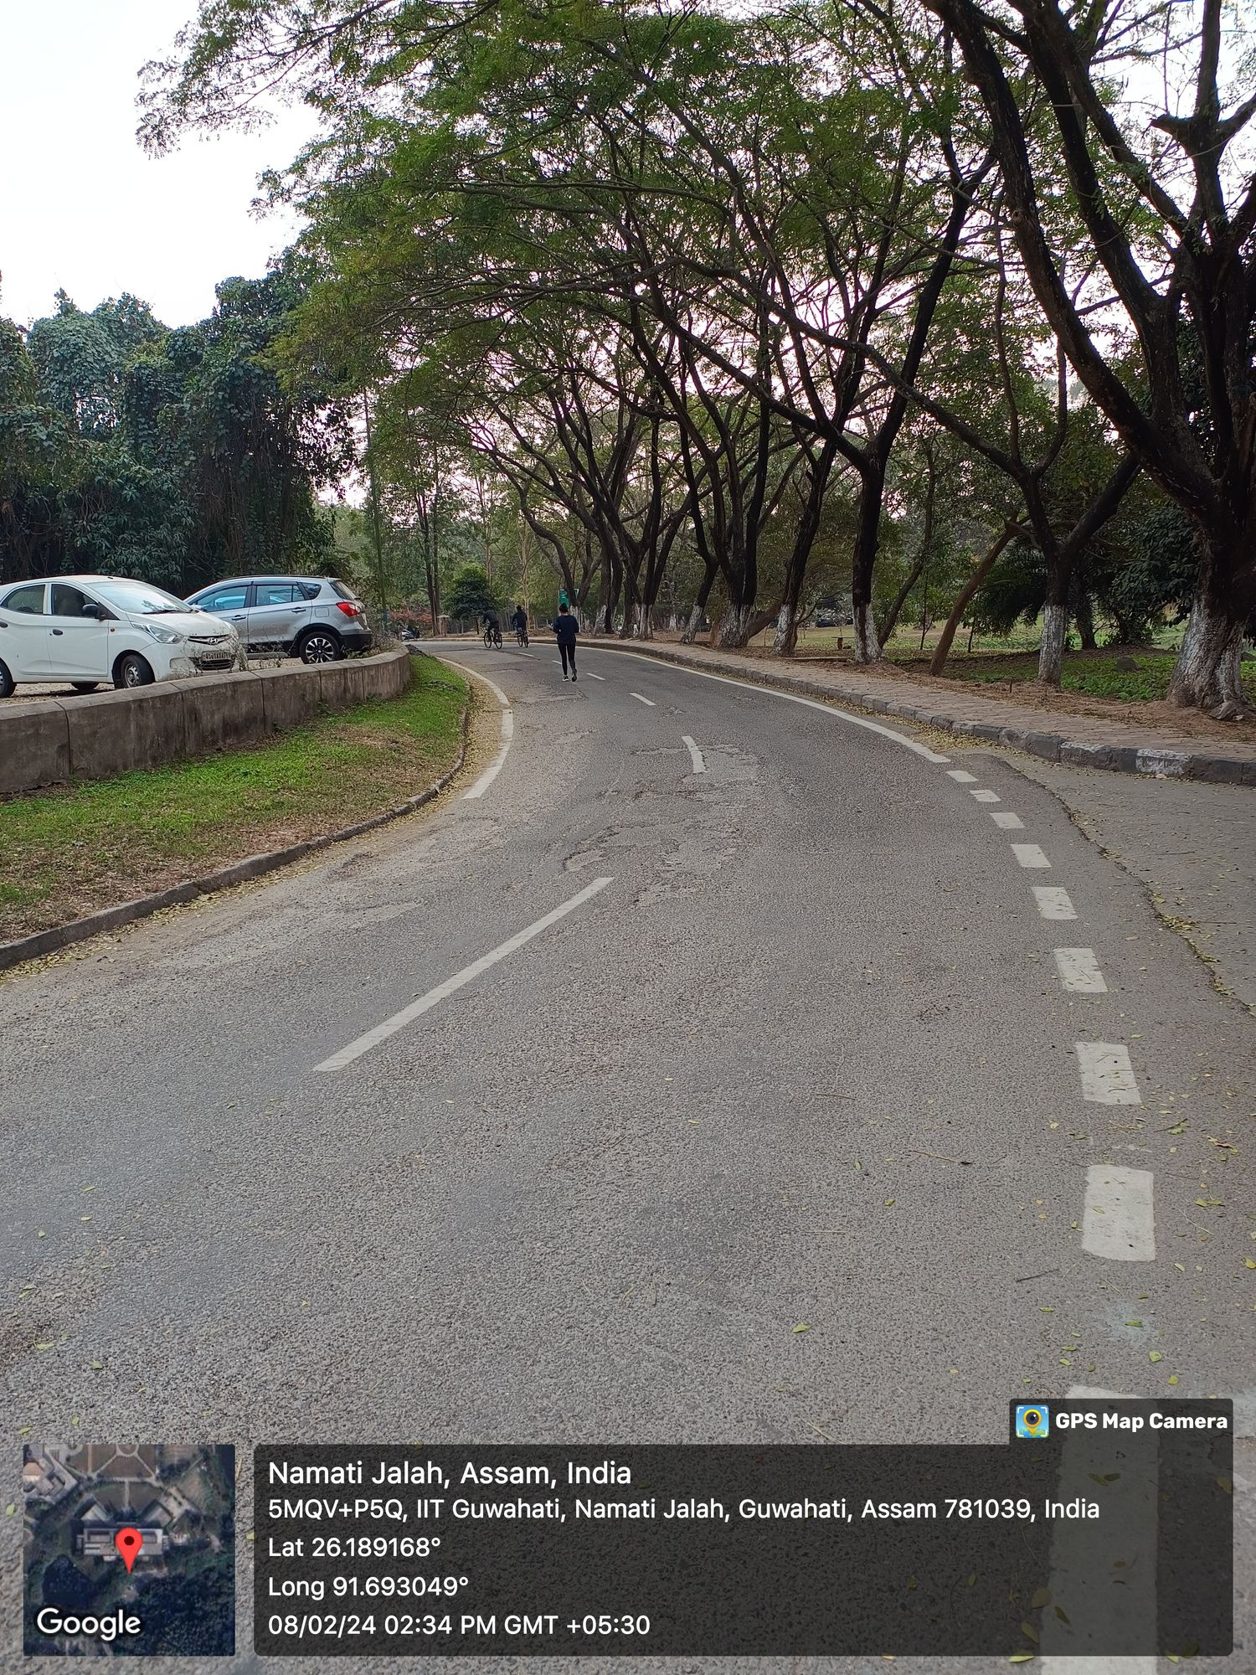
Stripping
This defect is characterized by the separation of bitumen film from the surfaces of the aggregate particles, due to the presence of moisture.
This may lead to loss of bond between bitumen and aggregate and subsequently to loss of cohesion in mixture.

Slide 4
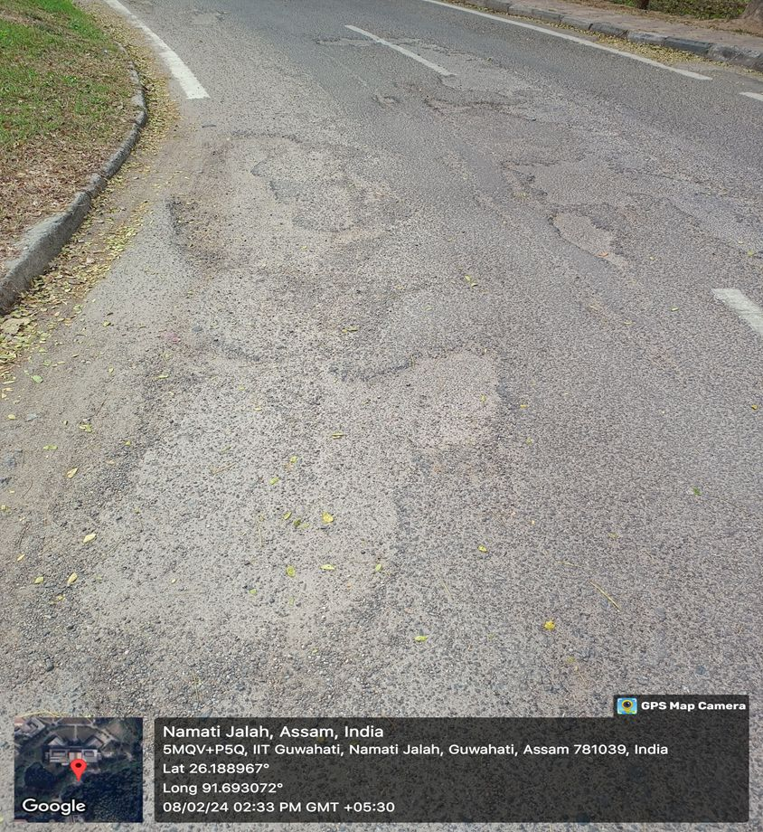
Causes:
Presence of moisture on aggregate surface when it comes in contact with the bitumen.
As here the side drain is blocked because of which the water remains stagnant here leads to loss of bond between aggregates and asphalt binder.

Slide 5
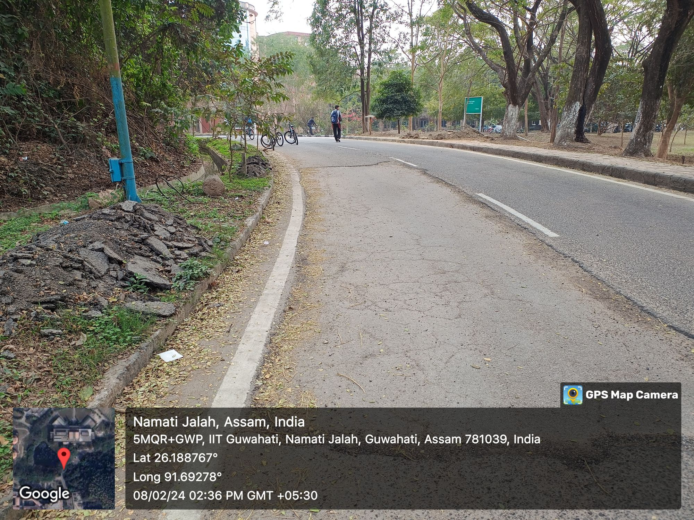
Alligator Cracking
Alligator or map cracking is characterized as a series of interconnected cracks, having small irregular blocks in pavement surface which resemble the skin of an alligator.

Slide 6
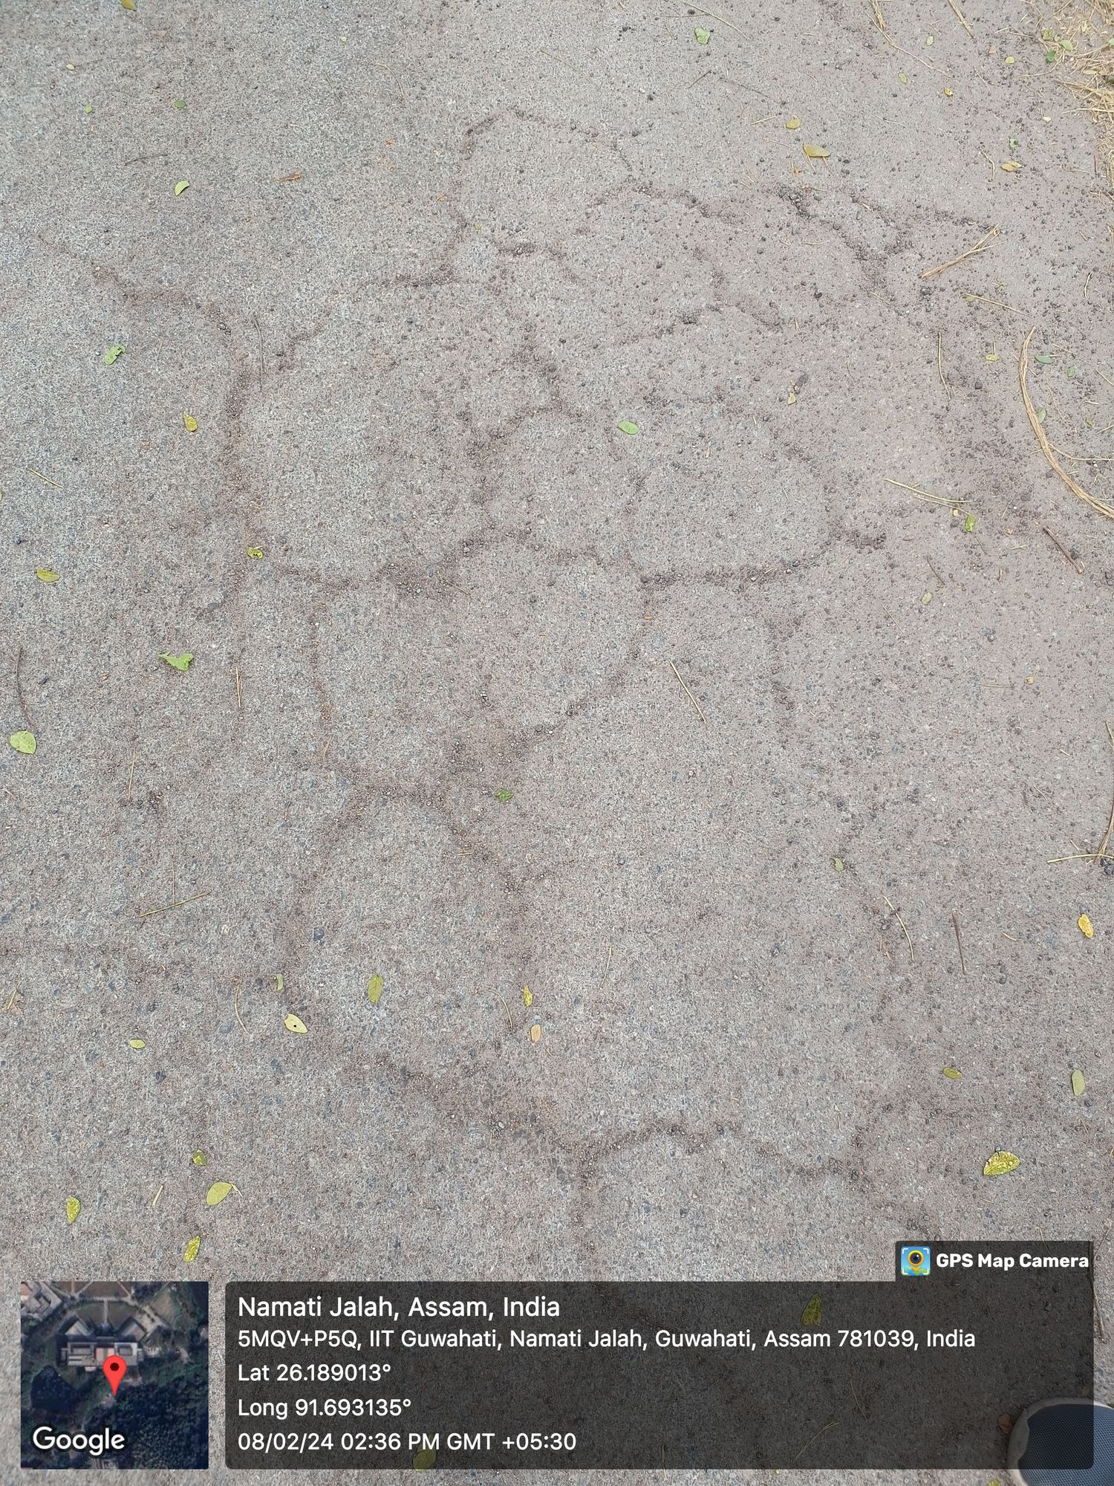
Causes:
Weakening of sub-grade or lower layers of the pavement due to ingress of excessive moisture to pavement and saturation.
These cracks initiate at the bottom of the asphalt pavement within the flexible system due to tensile strains.
With repeated traffic loadings, the cracks initiated at propagate upward to the road surface through DBM and then Bituminous concrete courses.

Slide 7
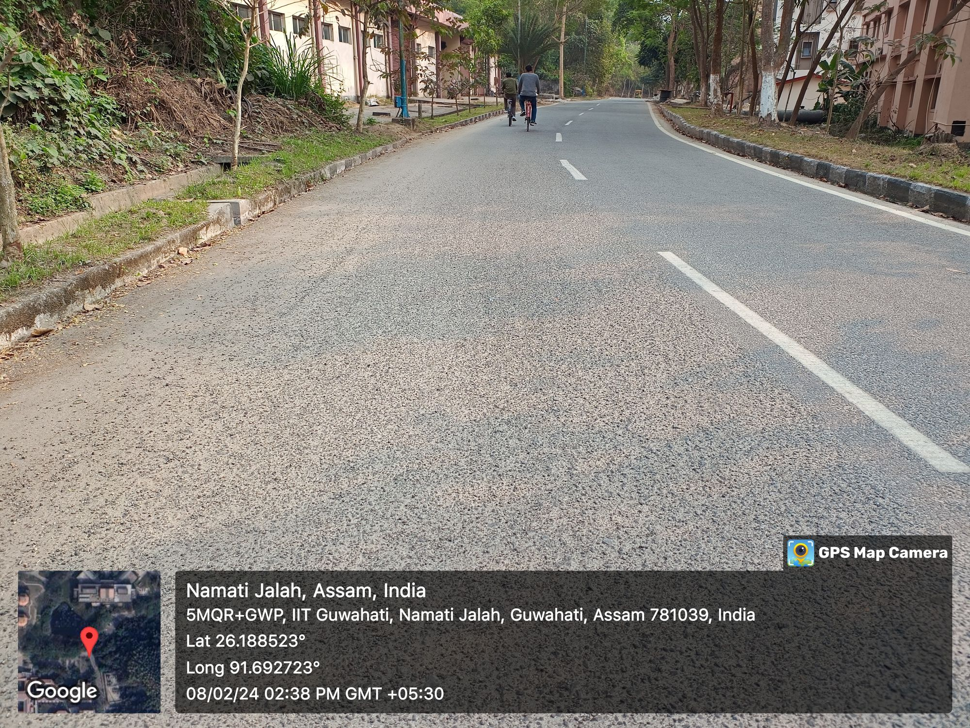
Ravelling
Ravelling is defined as progressive separation and dissociation of fine aggregate particles and binder from the bituminous surface. Normally, fine aggregates wear away first followed by coarse aggregates.
The ravelling process generally starts from the surface downward or from the edge inward.
Pavement surface lead to rough and jagged appearance after occurrence of ravelling.

Slide 8
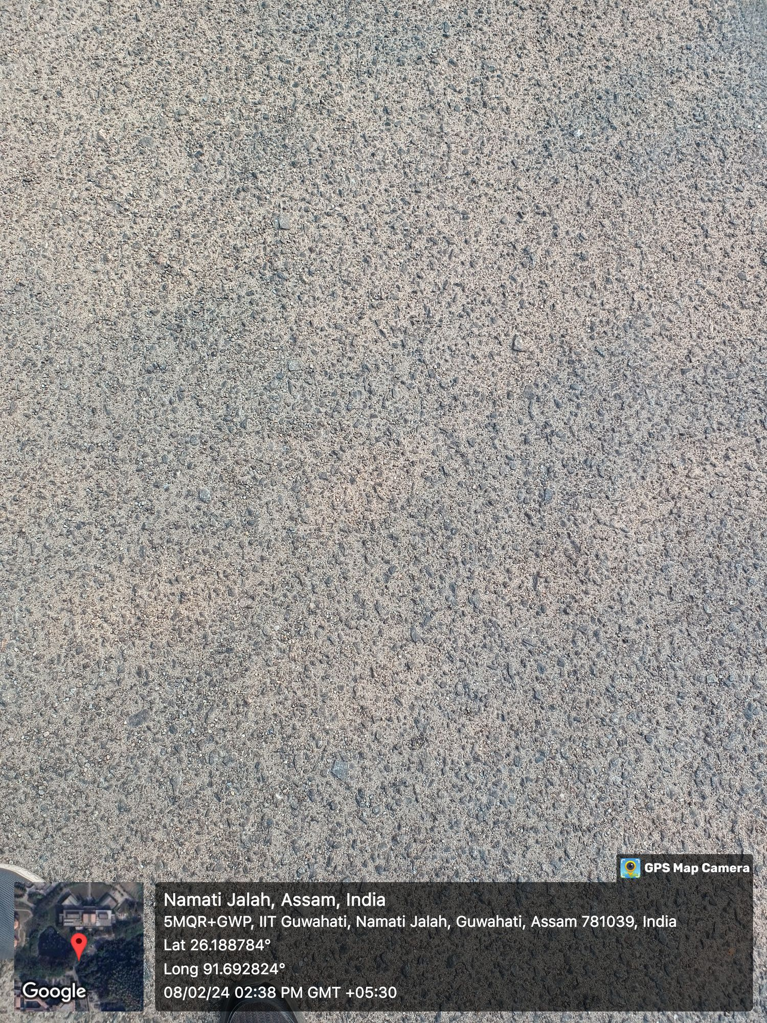
Causes
Ravelling occurs due to lack of sufficient cohesion within the asphalt mix due to low in-place density or inadequate binder content.
Here Ravelling is caused by the action of water and it causes stripping of bitumen.

Slide 9
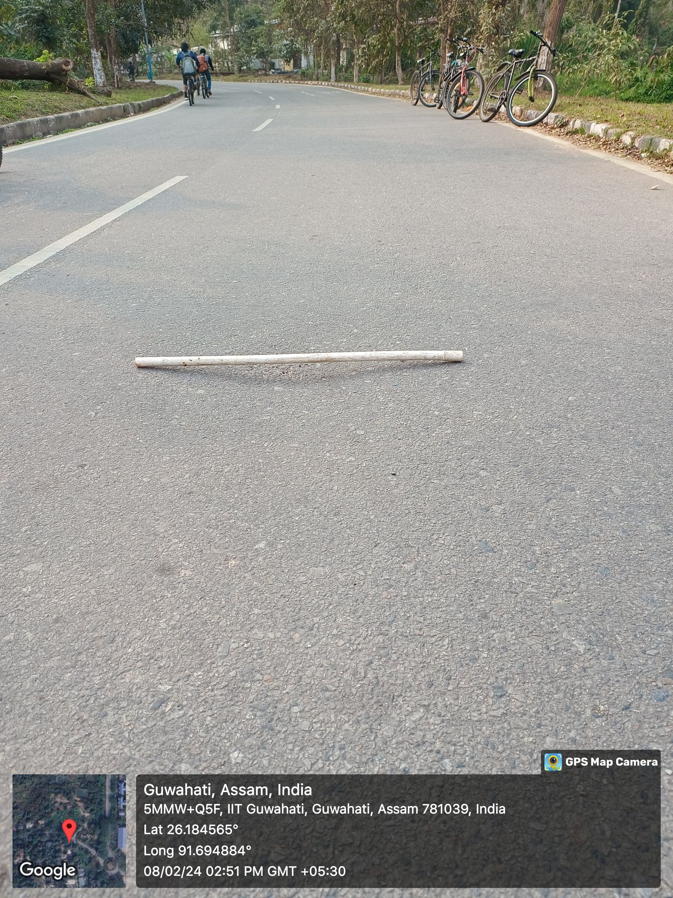
Shallow depressions
Shallow depressions are isolated low areas of limited size, dipping about 25 mm or more below the profile, where water will normally become stagnant.
Causes:
Subgrade settlement resulting from inadequate compaction during construction.

Slide 10
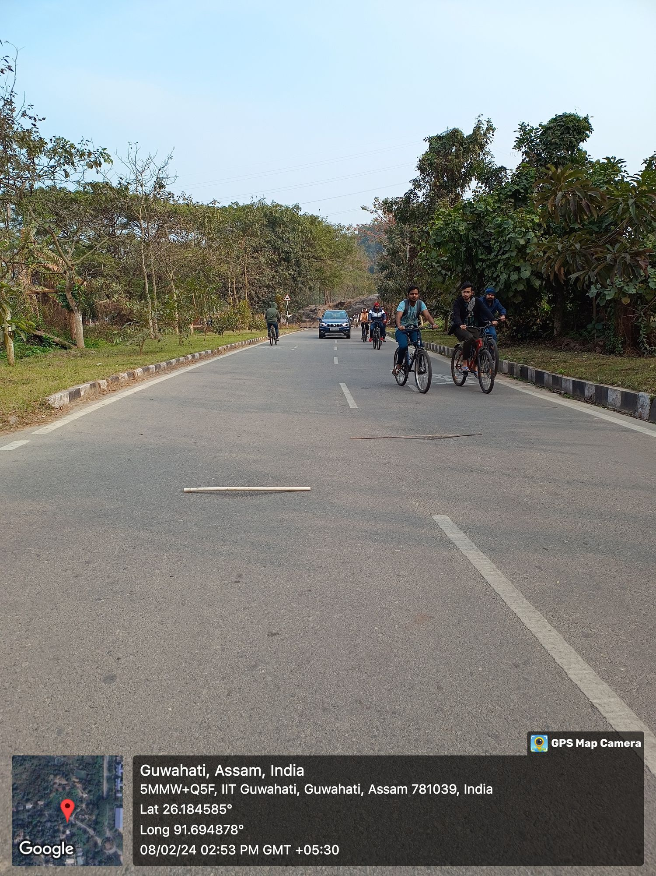
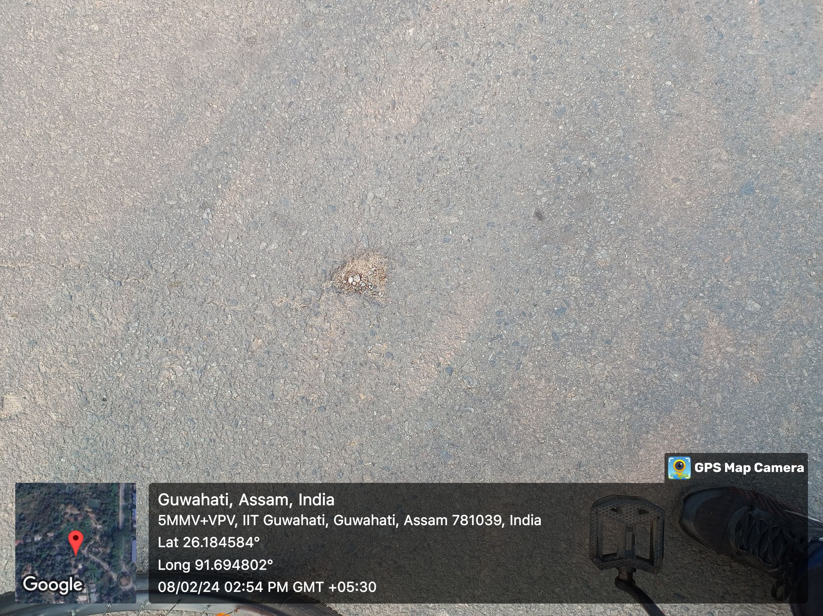

Slide 11
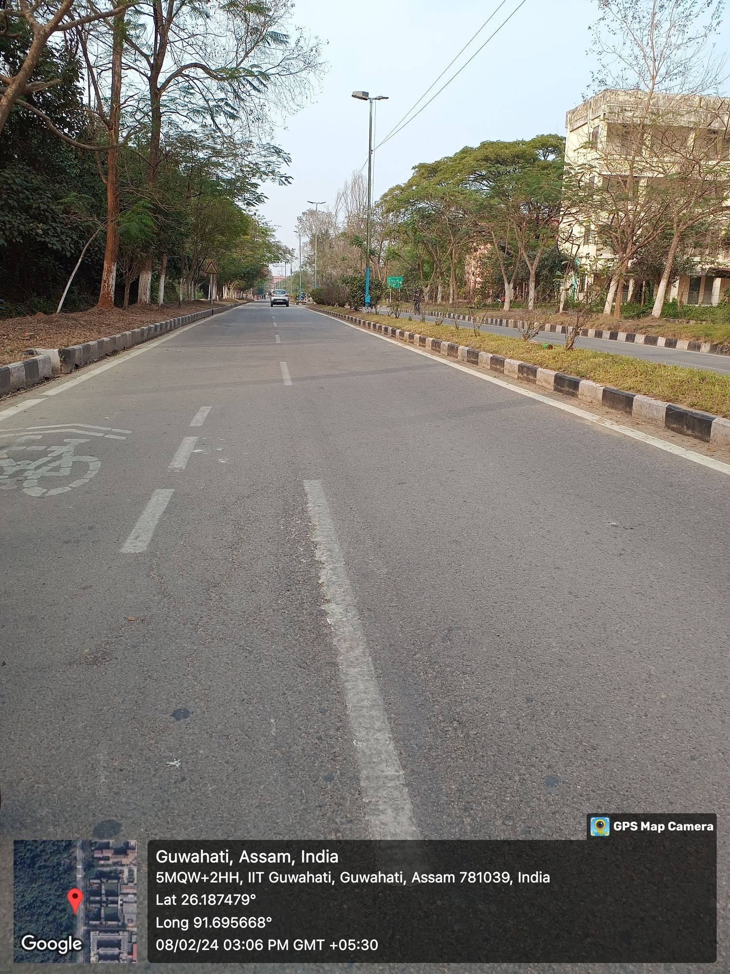
Fatigue Cracking
This is the type of distress in which series of interconnected cracks appears due to the fatigue failure of the HMA surface when the pavement experience repeated traffic loading.

Slide 12
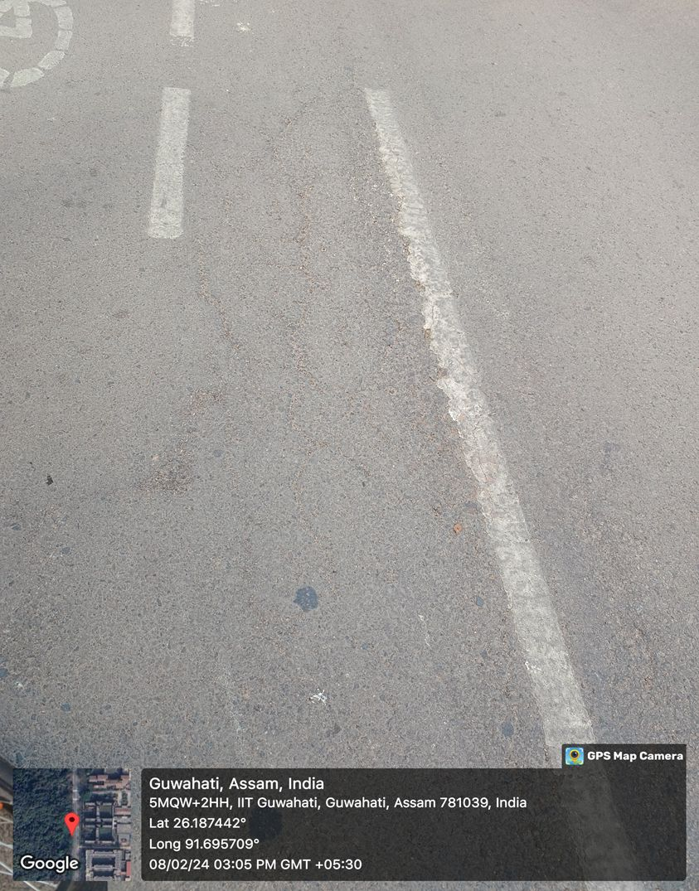
Causes:
Here fatigue cracks are caused because of aging of asphalt mixture, due to which brittleness of the asphalt binders increases which got hardened over time, leading to increased cracking under cyclic traffic loads.

Slide 13
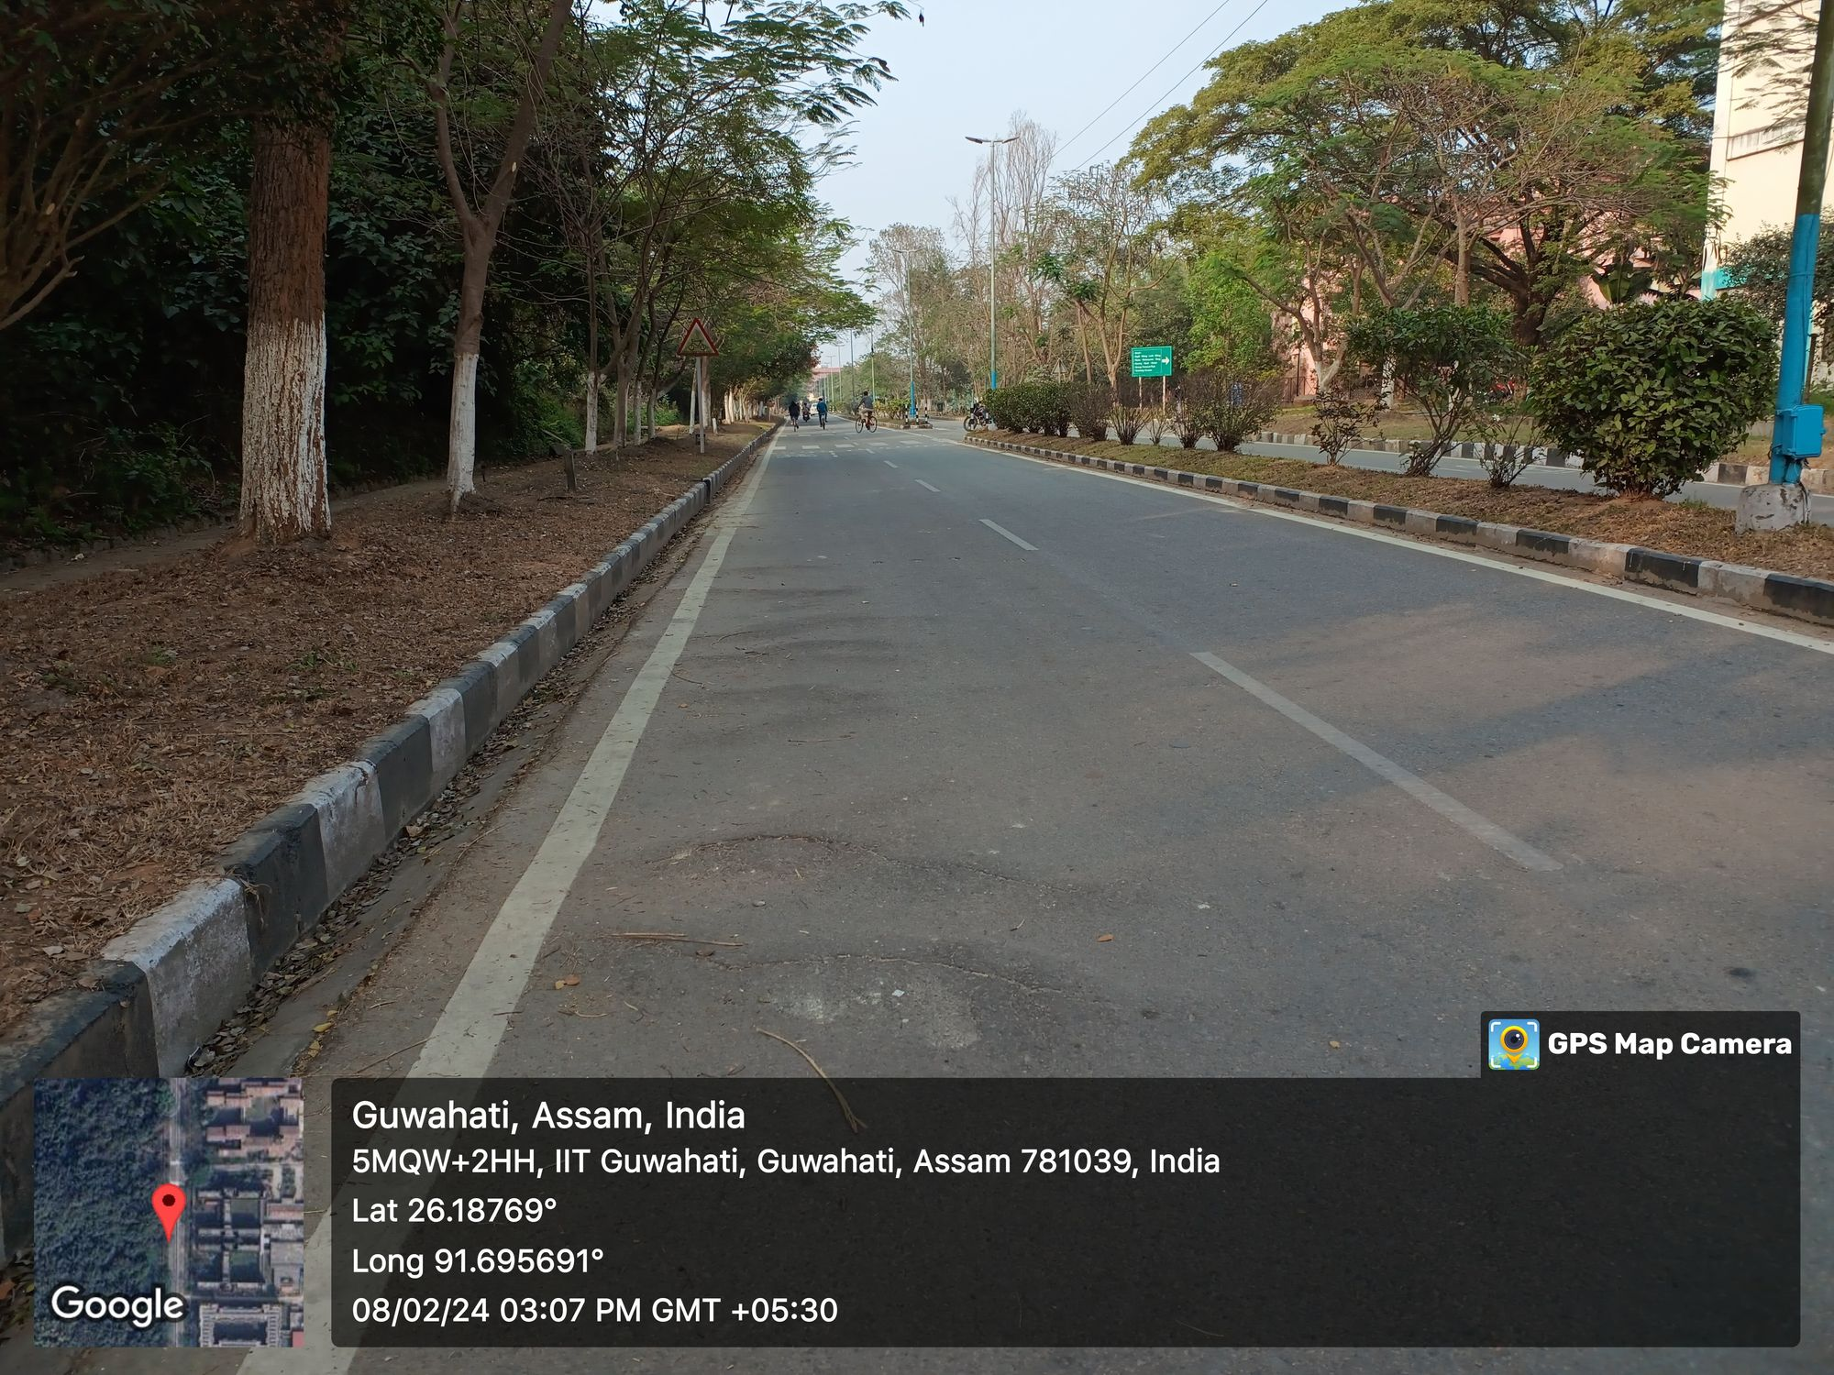
Upheaval
Upheaving of bituminous pavement from it original paved level.

Slide 14
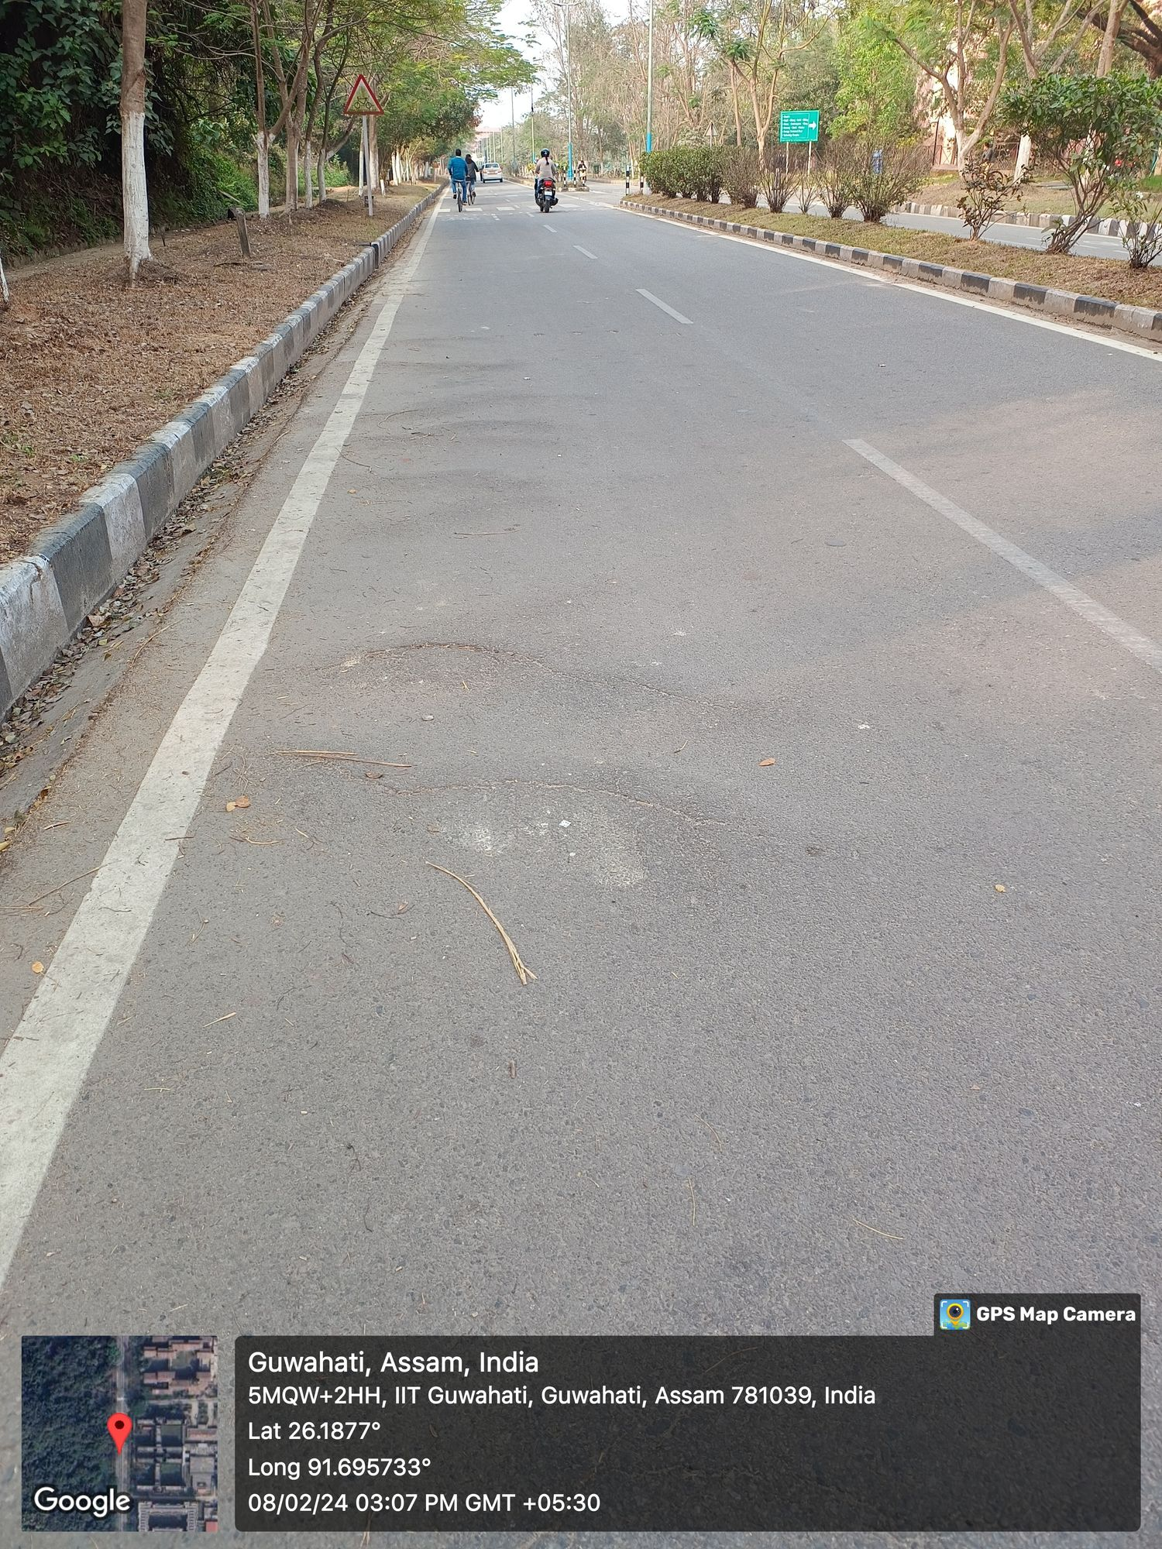
Causes:
Due to extension of nearby tree roots.

Slide 15
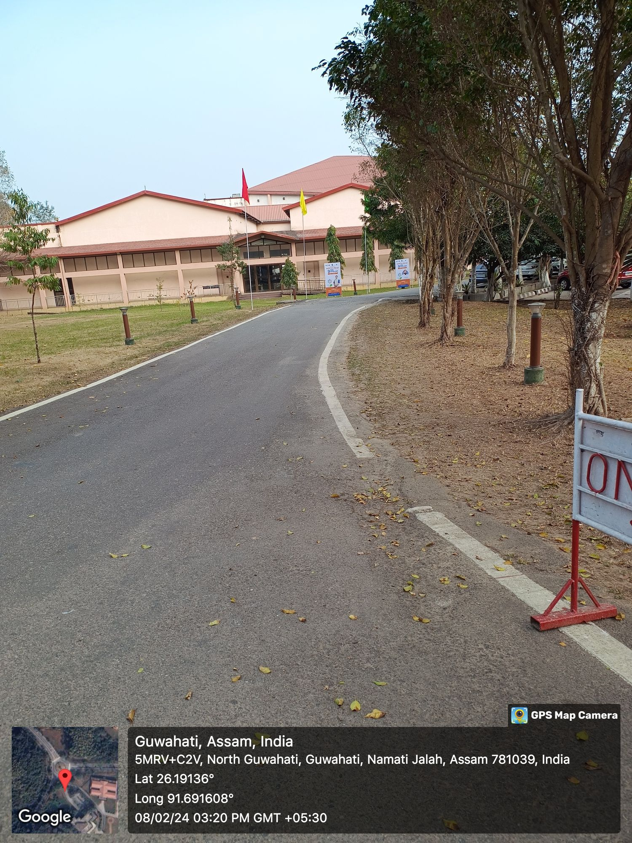
Settlement
Settlements characterized by relatively large deformations of the pavement compared to shallow depressions.

Slide 16
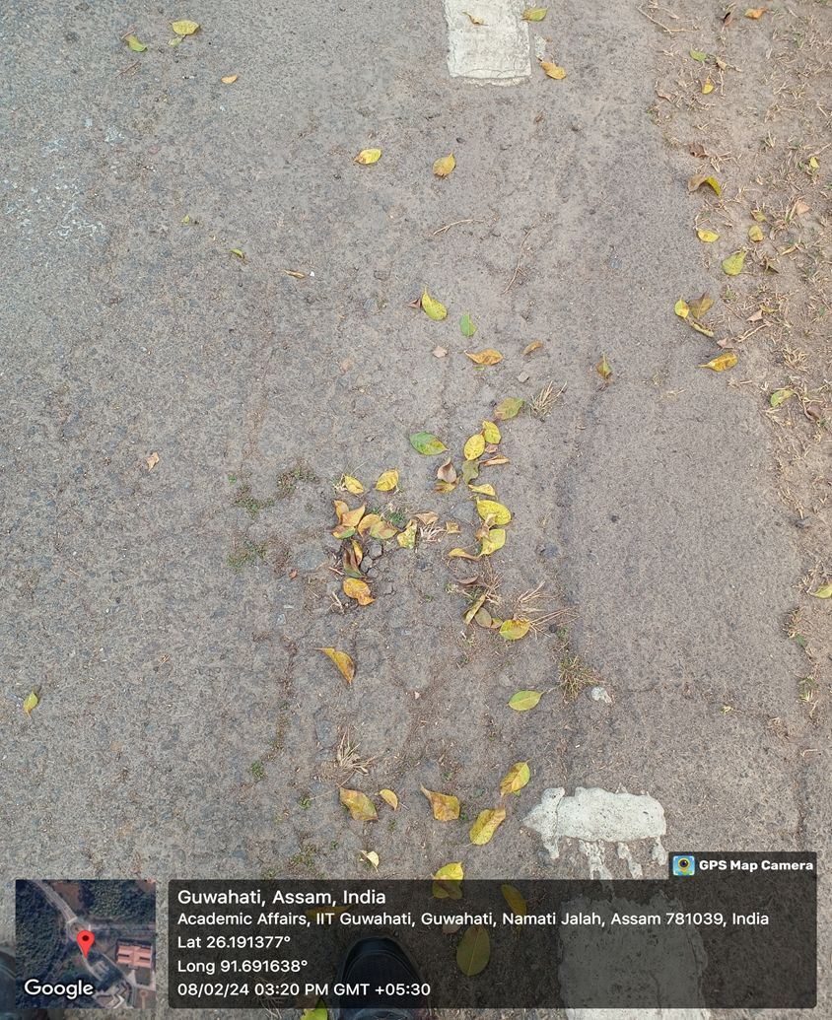
Causes:
Due to inadequate compaction of subgrade at corner during the construction.

Slide 17
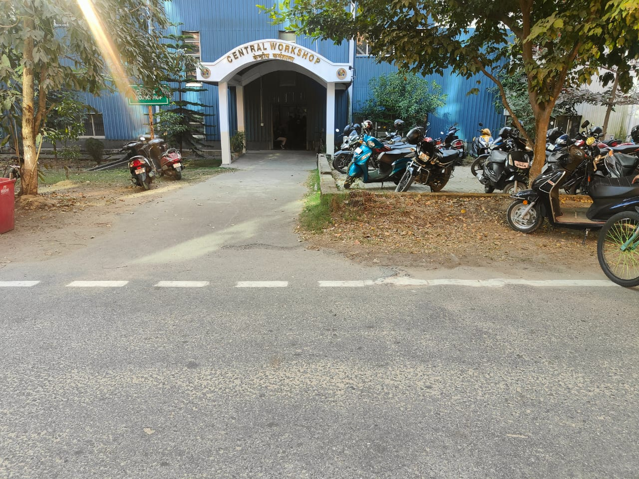
UPHEAVEAL

Slide 18
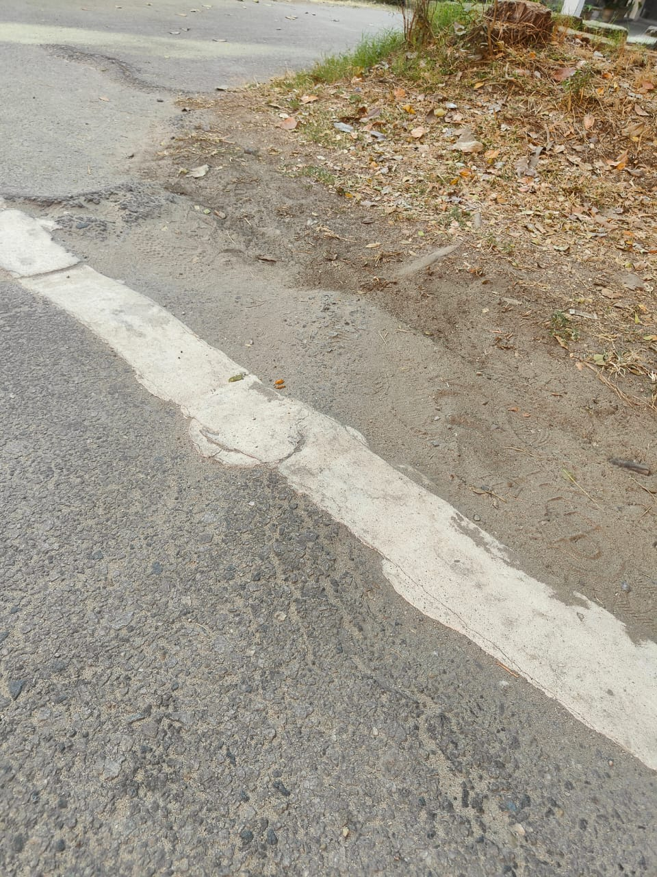
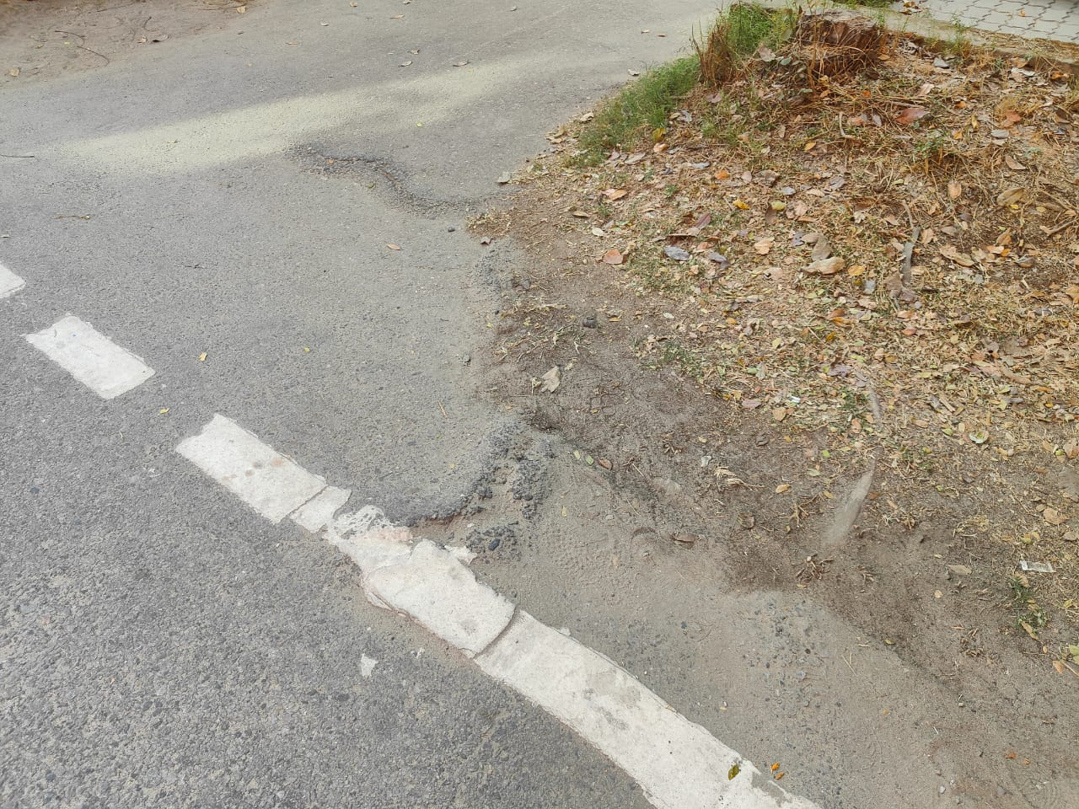
Root heave, sometimes called pavement heave.
It is triggered by tree roots that do not have sufficient growing space underground.
It is caused largely by compacted soil that has been densified to provide structural stability for the overlying pavement.

Slide 19
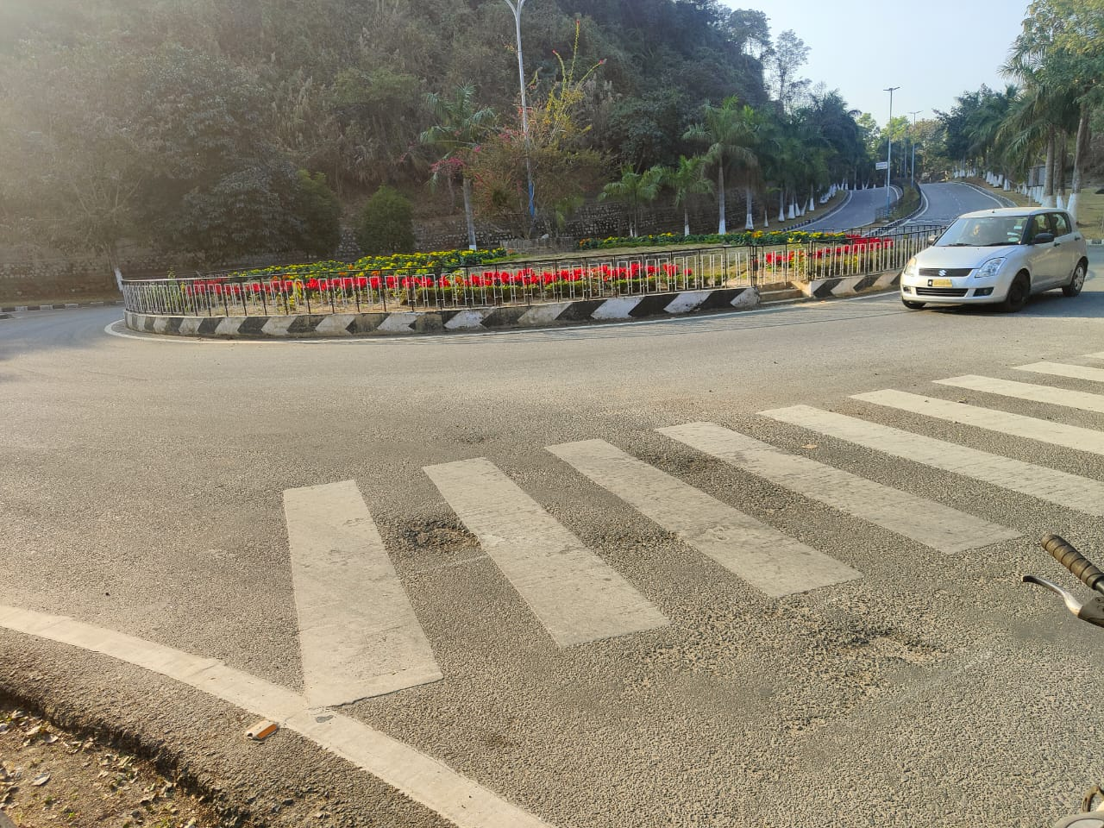
Pothole:
Small, bowl-shaped depressions in the pavement surface that penetrate all the way through the HMA layer down to the base course.
They generally have sharp edges and vertical sides near the top of the hole.

Slide 20
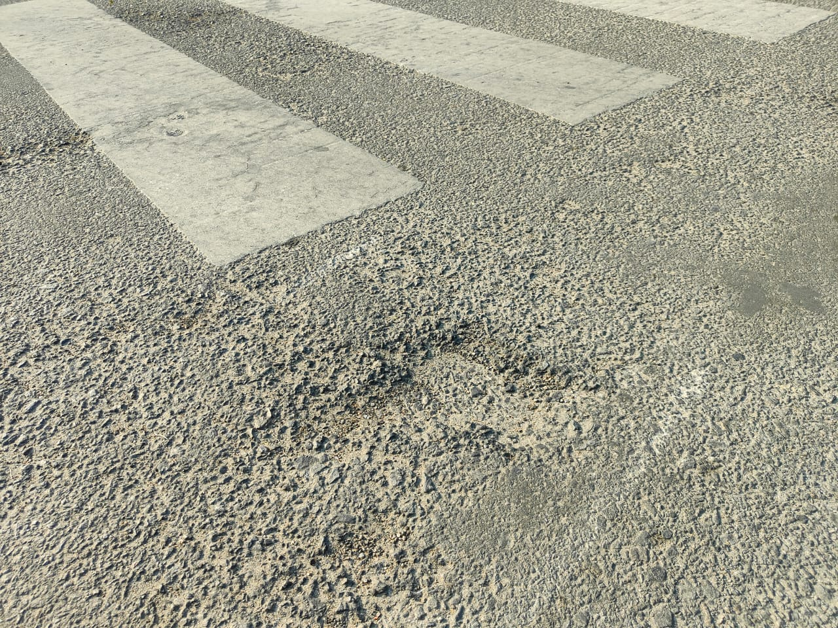
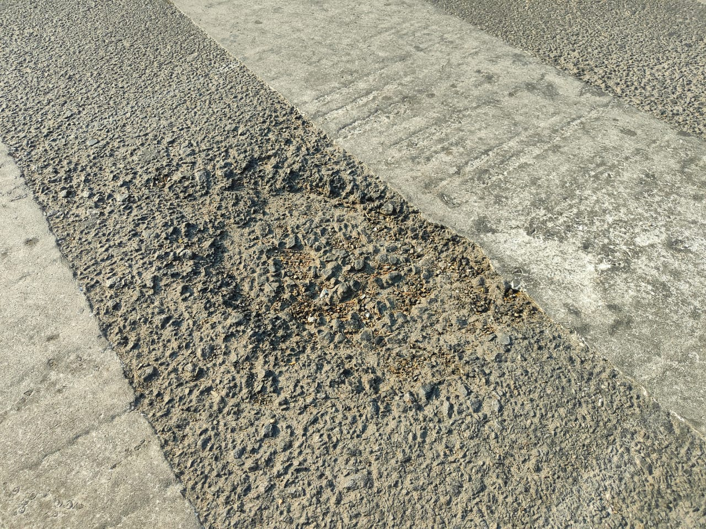
Potholes are the end result of fatigue cracking.
As fatigue cracking becomes severe, the interconnected cracks create small chunks of pavement, which can be dislodged as vehicles drive over them.

Slide 21
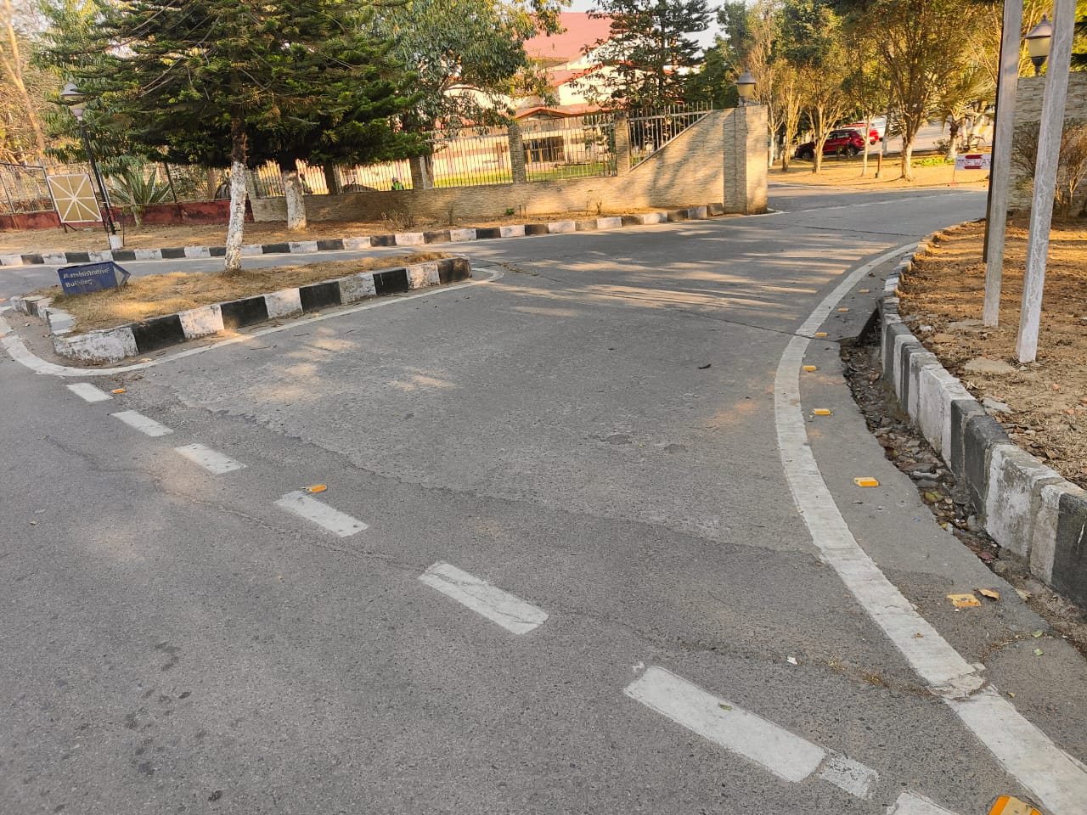
Joint Reflection Cracking

Slide 22
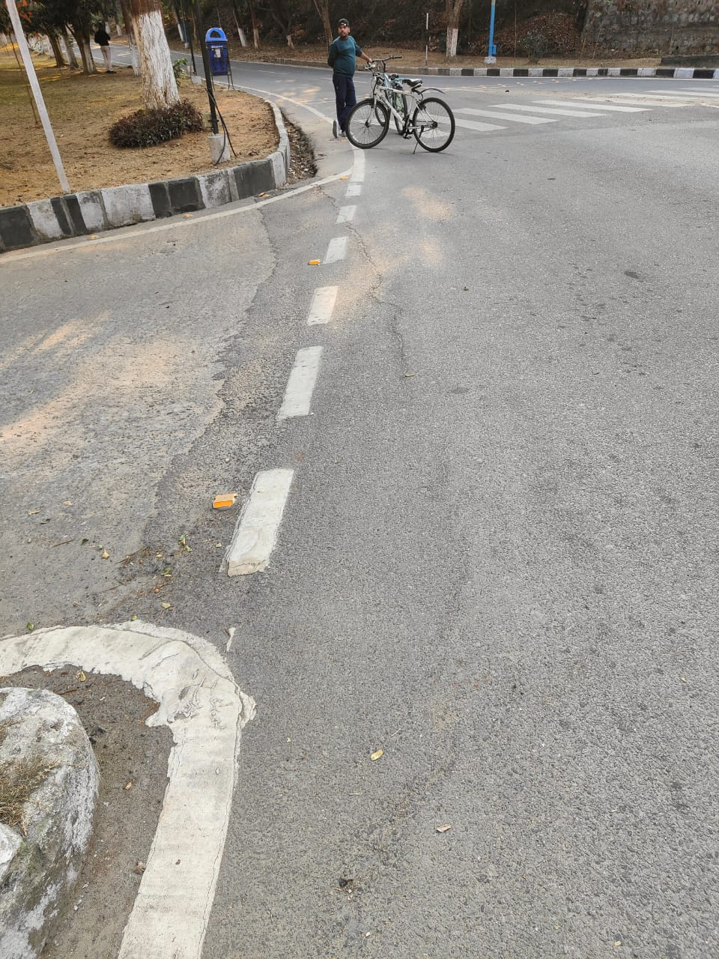
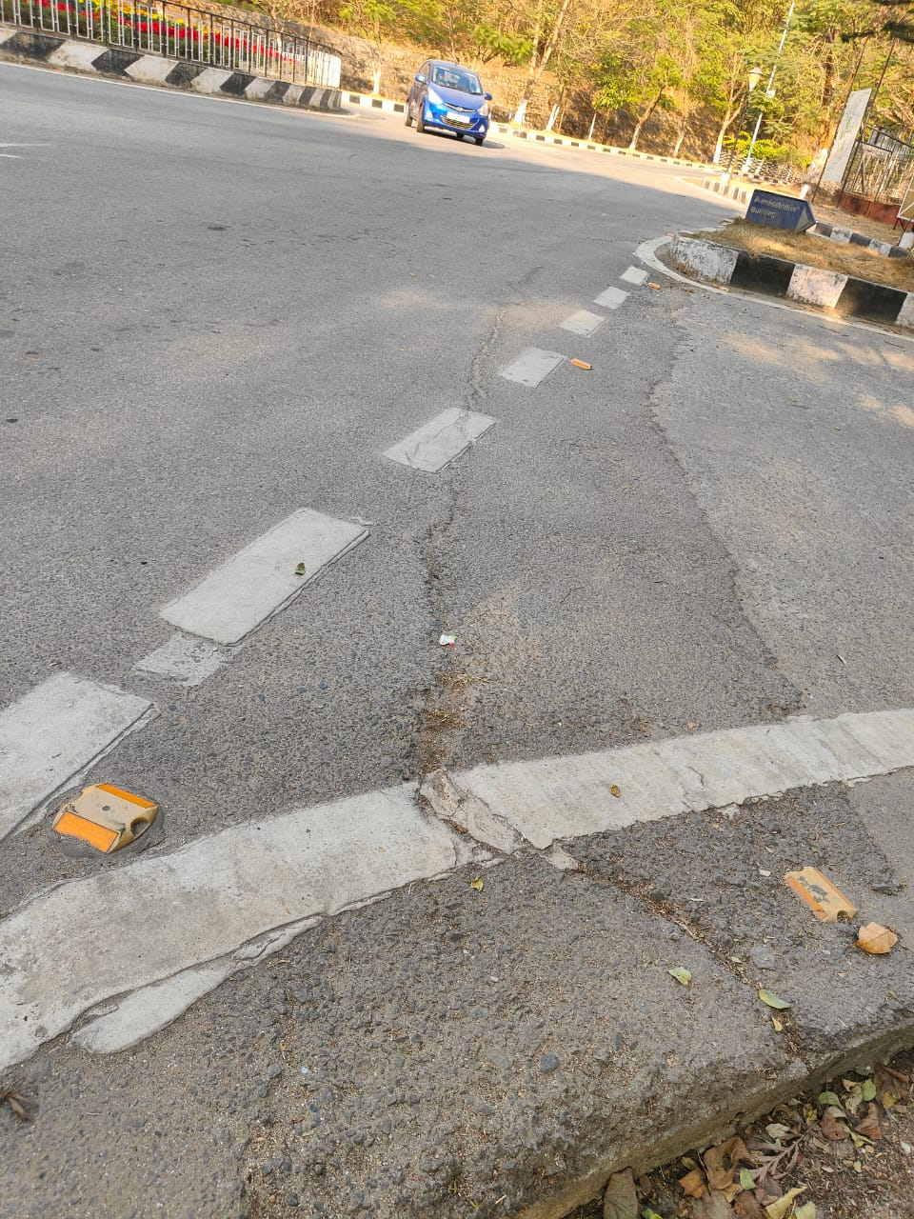
Cracks in a flexible overlay of a rigid pavement.
The cracks occur directly over the underlying rigid pavement joints.
Joint reflection cracking does not include reflection cracks that occur away from an underlying joint or from any other type of base

Slide 23
THANK YOU

